Slide 1
Development of a Machine Learning-Driven Virtual Screening Platform for the discovery of PPI Inhibitors in Cystic Fibrosis
DOCTORAL ADVISORY COMMITTEE MEETING
Research Guide:
Dr. Manoov Rajapandy
Senior Assistant Professor
Department of Computer Science
and Engineering
Vellore Institute of Technology
Vellore
Research Scholar:
Ms. Dhivya Gunasekaran
24PDT0002
School of Biosciences and Technology
Vellore Institute of Technology
Vellore

Slide 2
Research Profile
Skills in Bio-informatics
Participated in ‘Training on Bioinformatics’ held from 24th June to 1st July 2006 at Sai’s Biosciences Research Institute Pvt Ltd.
Participated in ‘Industrial training program & Wetlab Training for Bioinformatics’ conducted by NIOT from 19th June to 23rd June 2006.
Participated in National workshop on Bioinformatics held on 25th March 2006 Arunai Engineering college, Thiruvannamalai.
Journal Publications
Dhivya Gunasekaran, N. Chandrasekaran, David F L Jenkins. “Plain polysterene microplastics reduce the toxic effects of ZnO particles on marine microalgae Dunaliella salina”. Journal of Environmental Chemical Engineering 8(5), 104250, 2020
Sekar kumaran, Gunasekaran Dhivya “Phytoremediation of heavy metals (Cu. Pb, Zn, Cr) on Golden doranda, Balsam & Erwa plants” Journal of chemical and pharmaceutical research 2013,5(12):1500-1511

Slide 3
Contents
Introduction and Background
Problem statement
Previous Research
Research Gap
Objectives
Methodology / Work Plan
Proposed Course work
References

Slide 4
Introduction and Background
Cystic Fibrosis (CF) is a fatal hereditary condition marked by thicker mucus production, which can cause problems with respiratory systems (Biswajit et al 2024).
CF patients affected with chronic lung infections are mainly due to the pathogen, Pseudomonas aeruginosa (Pa).
Cystic fibrosis transmembrane conductance regulator (CFTR) protein is encoded by a defective gene on chromosome 7 which leads to life-threatening lung infections (Rowe et al 2005).
CF is a severe, life-limiting genetic disorder caused by mutations in the CFTR gene, leading to dysfunctional CFTR protein and impaired ion transport (Biswajit et al 2024).
The chronic nature of CF leads to repeated courses of potentially toxic drugs for many years, increasing the risk of side eﬀects, such as drug resistance, impairment of renal function and hearing (Flume et al., 2007).
The quality of life and survival rates of CF patients can be improved by early identification and individualized therapy measures.

Slide 5
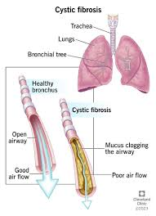
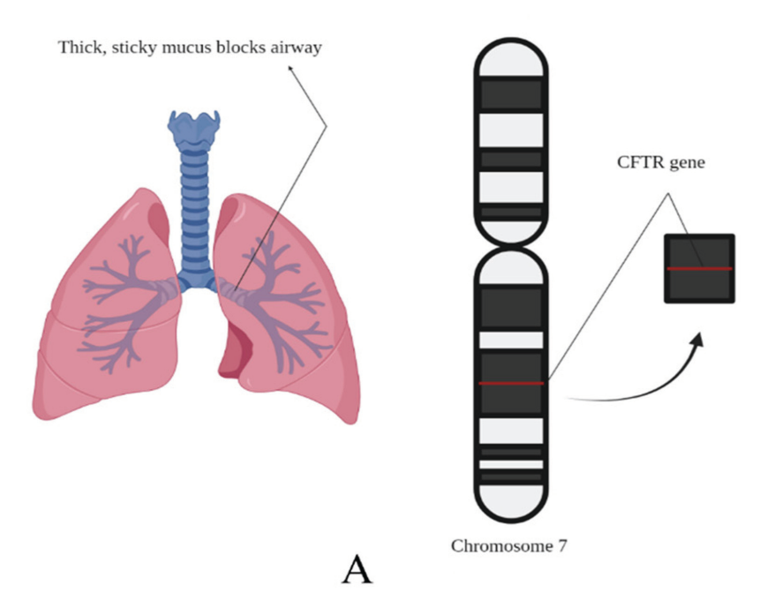
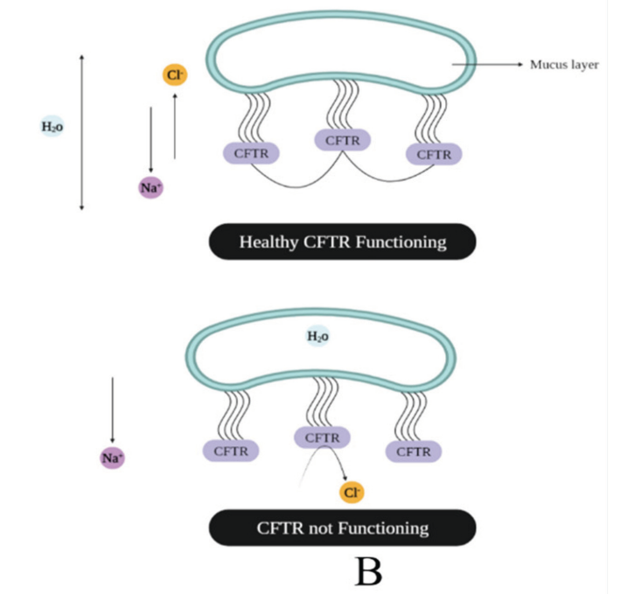
(A) Cystic fibrosis and the CFTR gene in chromosome seven whose malfunction is responsible for the disease.
(B) Functioning of healthy and unhealthy CFTR

Slide 6
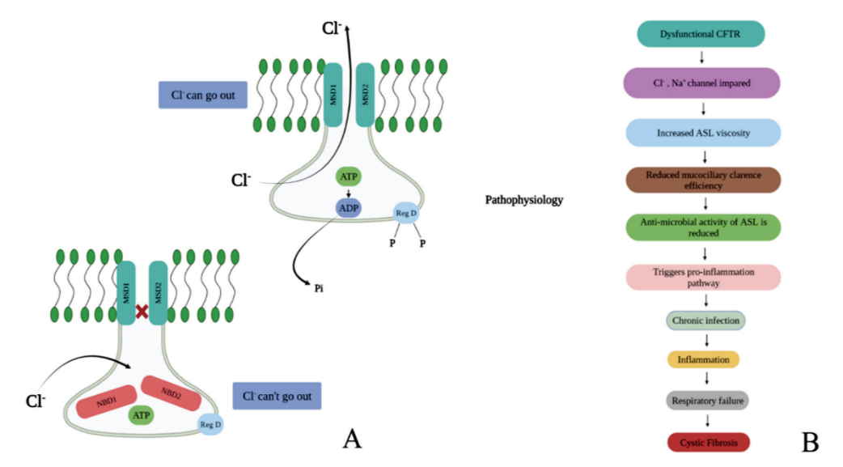
Dysfunctional CFTR
Cl-, Na+ channel impaired
Increased ASL vicosity
Reduced mucocillary clearance efficiency
Anti-microbial activity of ASL is reduced
Triggers pro-inflammation pathway
Chronic infection
Inflammation
Respiratory failure
Normal CFTR in which the Cl- can pass; as a result, the concentration and ASL viscosity are maintained, and when Cl- cannot pass, CF can be caused
Cystic fibrosis
(B) pathophysiological process

Slide 7
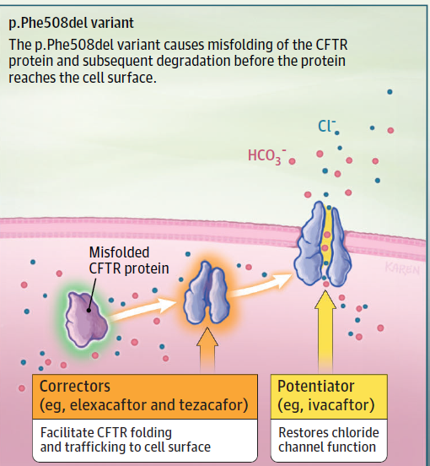
Problem statement - Protein–protein interactions (PPIs)
PPIs play a crucial role in CFTR misfolding, degradation and defective trafficking, particularly in the F508del mutation (Sirvani et al., 2015).
F508del mutation - Inappropriate modifications after translation are thought to be the cause of a protein's inability to be bound to the proper cellular site.
Existing treatments like Lumacaftor and Ivacaftor have limited efficiency, high cost, and variable patient response, highlighting the need for new therapeutics.
CFTR variants in cystic fibrosis

Slide 8
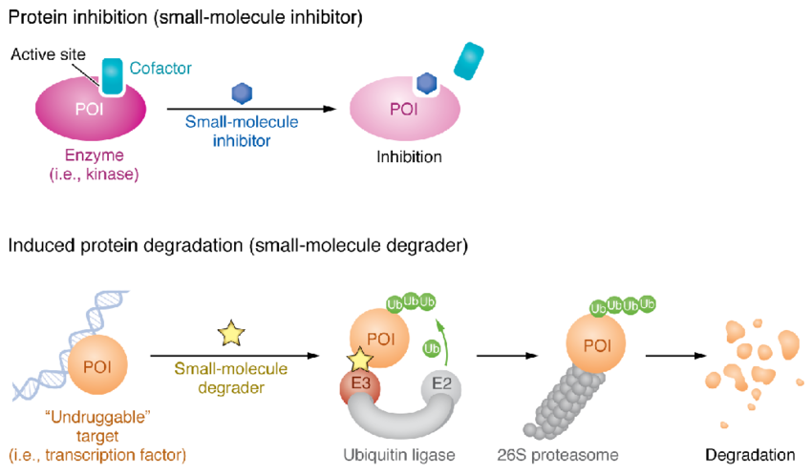
Protein inhibition (Identification of Small-molecule inhibitor)
Enzymes, ion channels, and receptors act as proteins for target-based drug discovery (Santos etal, 2017).
The macromolecular interactions of proteins such as protein–DNA and protein–protein interactions (PPIs) are key targets to expand the druggable proteome (Lu et al., 2020) which therapeutically tackle various diseases (Philipp et al., 2024).
PPI targeting drugs are advantageous over other types of drugs (vaccines or antivirals) circumventing mutations in (pathogens/genomes) that results in immune evasive properties.

Slide 9
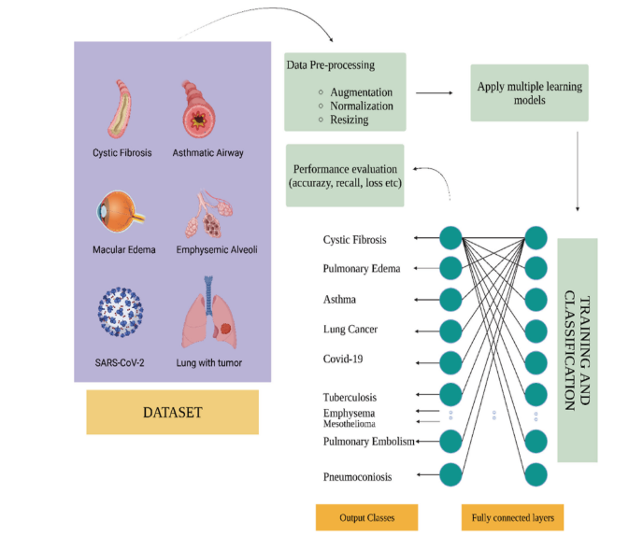
Importance of Machine Learning (ML) in Cystic Fibrosis
Machine learning (ML) have emerged as powerful tools in virtual screening and drug discovery but are under utilized in identifying PPI inhibitors for Cystic fibrosis.
This study proposes developing an ML-driven platform for predicting, screening, and validating novel PPI inhibitors for cystic fibrosis treatment.
ML based algorithms are revolutionizing CF diagnosis by utilizing huge genetic, clinical, and imaging databases.
Artificial Intelligence in Cystic fibrosis

Slide 10
CFTR-Interacting Proteins for targeting PPI Inhibitor
Protein | Full Name | Biological Role | Relevance to CFTR & PPI Targeting
CAL | CFTR-Associated Ligand | Adaptor protein promoting CFTR degradation via lysosomal trafficking | Competes with NHERF1 for CFTR binding - inhibition could prolong CFTR membrane stability
HSP90 | Heat Shock Protein 90 | Molecular chaperone that stabilizes folding intermediates | Stabilizes misfolded CFTR - inhibition may alter folding trajectory and degradation outcomes
NHERF1 | Stress-Induced Phosphoprotein 1 | Co-chaperone linking HSP70 and HSP90 in CFTR folding complexes | Mediates CFTR chaperone complex - PPI disruption may modulate folding pathway

Slide 11
Research Gap
Machine learning based virtual screening approach identifies and prioritize small-molecule inhibitors targeting CFTR-associated protein-protein interactions for Cystic fibrosis treatment.

Slide 12
Objectives
Aim
To develop a machine learning based platform to identify and validate PPI inhibitors targeting CFTR in Cystic Fibrosis and assess their drug potential through computational methods.
To curate and preprocess a high-quality dataset of protein-protein interactions (PPIs) relevant to CFTR dysfunction in Cystic Fibrosis.
To design and train machine learning models to predict small molecules with potential to inhibit CFTR-related PPIs.
To implement a virtual screening pipeline integrating the trained ML models for rapid prioritization of candidate inhibitors.
To validate the top-ranked candidate inhibitors through molecular docking, dynamics simulations, and binding free energy analysis.
To evaluate the therapeutic potential of identified inhibitors through ADMET profiling.

Slide 13
Objective 1: To curate and preprocess a high-quality dataset of protein-protein interactions (PPIs) relevant to CFTR dysfunction in Cystic Fibrosis.
Previous Research
Author/Year | Title | Journal | Relevant Research Gap | Key findings
David et al., 2018 | Data Resource Profile: The UK Cystic Fibrosis Registry | International Journal of Epidemiology | Underuse of large-scale clinical data for CF research. | Provides longitudinal clinical data on >12,000 CF patients; supports real-world outcome and drug studies.
Iazzi et al., 2022 | Proximity Profiling of the CFTR Interaction Landscape in Response to Orkambi | Int. J. Mol. Sci. | Limited understanding of CFTR interaction changes with ∆F508 mutation and drug modulation | Identified 474 WT and 626 ∆F508-CFTR interactors using BioID. Orkambi altered specific interactions; VAPB and NOS1AP validated as functionally important
Melissa et al., 2023 | A Proteomic Survey of the Cystic Fibrosis Transmembrane Conductance Regulator Surfaceome | International Journal of Molecular Sciences | Limited understanding of CFTR’s surface interactors and variant-specific PPIs. | Identified 113 high-confidence CFTR surface interactors; highlighted differences between WT and ∆F508 CFTR.

Slide 14
Methodology/ Work plan
Identify key targets for CFTR - CAL, HSP90, NHERF1
Data Source Identification – BioGRID, STRING, PDB
Extract PPI Data
Filter and curate the Dataset
Annotate Protein Functions and Pathways
Post translational modifications (trafficking, folding, degradation, channel function).
Format and Standardize the Dataset
Integrate to CFTR Mutation Data

Slide 15
Objective 2: To design and train machine learning models to predict small molecules with potential to inhibit CFTR-related PPIs.
Previous Research
Author/Year | Title | Journal | Relevant Research Gap | Key findings
Wang et al., 2022 | Advanced graph and sequence neural networks for molecular property prediction and drug discovery | Bioinformatics | Lack of comprehensive and customized tools integrating both graph and sequence models for molecular property prediction, especially on imbalanced datasets | Developed AdvProp, a suite of ML models including ML-MPNN and contrastive-BERT; achieved top performance on AI Cures challenge with improvements in ROC-AUC and PRC-AUC.
Chandak & Wong, 2021 | EDock‐ML: A web server for using ensemble docking with machine | Protein Science | Inconsistent performance of ensemble docking due to lack of rigorous theory for using multiple docking | Introduced EDock-ML, combining ensemble docking with ML (SVM, RF, LR, KNN); target-specific models enhance compound classification; accessible web platform developed.
Díaz-Eufracio & Medina-Franco, 2022 | Machine Learning Models to Predict Protein–Protein Interaction Inhibitors | Molecules | Limited use of ML to classify PPI inhibitors using molecular fingerprints despite growing public PPI data | Demonstrated that RF with ECFP4 fingerprints gave the best performance; provided a pipeline for reproducible ML modeling; ensemble models improved classification of PPI inhibitors.
Kim et al, 2021 | Bayesian neural network with pretrained protein embedding enhances prediction accuracy of drug–protein interaction | Bioinformatics | Deep learning models need large datasets; uncertainty in predictions is underutilized | Combined transfer learning and Bayesian inference to improve DTI prediction accuracy; uncertainty quantification helps prioritize reliable predictions

Slide 16
Previous Research
Author/Year | Title | Journal | Relevant Research Gap | Key findings
Li et al, 2021 | Machine-learning scoring functions for structure-based virtual screening | WIREs Computational Molecular Science | Classical scoring functions are limited in predictive power; unclear how well ML scoring functions generalize | ML scoring functions outperform classical ones in SBVS; proposed strategies to handle benchmark bias; highlighted open-source tools and prospective use cases
Agyemang et al, 2020 | Multi-view self-attention for interpretable drug–target interaction prediction | Journal of Biomedical Informatics | Limited interpretability of deep learning-based DTI models and over-reliance on single descriptors | Proposed a multi-view self-attention model combining multiple compound and protein features; achieved competitive performance and interpretability for kinase datasets
Tang W et al, 2024 | In silico discovery of potential PPI inhibitors for anti-lung cancer activity | Frontiers in Chemistry | AI/ML-driven in silico workflow for PPI inhibitor identification and validation | Developed a workflow integrating pharmacophore modeling, virtual screening, molecular dynamics, and MM-GBSA to identify potential PPI inhibitors.
Philipp et al., 2024 | AI-guided pipeline for protein–protein interaction drug discovery identifies a SARS-CoV-2 inhibitor | Molecular Systems Biology | Lack of integrated AI pipelines for PPI-targeted drug discovery | Created an AI-ML workflow integrating AlphaFold-Multimer and ultra-large virtual screening for novel PPI inhibitors.

Slide 17
Methodology/ Work plan
Target selection for inhibition
(e.g., CFTR–CAL, CFTR–NHERF1, CFTR–HSP90)
Dataset Curation of Known PPI Inhibitors – ChEMBL, iPPI-DB
Data Preprocessing: Remove duplicates and standardize SMILES
Generation of Molecular Descriptors using Chemprop/Deepchem
Selection and Design of ML model
Model Training
Model Evaluation and Interpretation

Slide 18
Objective 3: To implement a virtual screening pipeline integrating the trained ML models for rapid prioritization of candidate inhibitors.
Previous Research
Author/Year | Title | Journal | Relevant Research Gap | Key findings
Kumar & Acharya, 2022 | Machine intelligence-driven framework for optimized hit selection in virtual screening | Journal of Cheminformatics | Low accuracy and high false positives in traditional VS; lack of unified CS-PS based ML frameworks | Developed A-HIOT framework integrating chemical and protein space; achieved ~90% accuracy in hit optimization; outperformed conventional ML/DL methods
Cozac et al, 2020 | Predicting inhibitors for SARS-CoV-2 RdRp using machine learning and virtual screening | Preprint (arXiv/Elix) | Need for RdRp inhibitors; limitations in docking when 3D structure isn't available | ML models (RF, SVM, XGBoost, etc.) predicted active compounds (e.g., remdesivir); docking confirmed low binding energy; identified repositioning candidates
Zhang et al, 2021 | An Integrated Deep Learning and Molecular Dynamics Simulation-Based Screening Pipeline Identifies Inhibitors of TIPE2 | Frontiers in Pharmacology | No known inhibitors for TIPE2 despite its therapeutic potential in cancer and inflammation | Identified 4 lead compounds from deep learning + MD pipeline; UM-164 showed strongest binding and disrupted TIPE2–PIP2 interaction
Chandak & Wong, 2021 | EDock-ML: A web server for using ensemble docking with machine learning to aid drug discovery | Protein Science | Lack of theory and guidance for using ensemble docking results effectively | Introduced EDock-ML, combining ensemble docking with ML (RF, SVM, LR, KNN); improved prediction of actives using protein-specific models

Slide 19
Previous Research
Author/ Year | Title | Journal | Relevant Research Gap | Key findings
McCloskey et al., 2020 | Machine Learning on DNA-Encoded Libraries: A New Paradigm for Hit Finding | Journal of Medicinal Chemistry | Underutilization of DEL data due to manual bias and limited scalability | ML models (GCNNs) trained on DEL data identified potent inhibitors (IC50 <10nM) for diverse targets; high hit rates (up to 72%) in large libraries
Graff et al., 2021 | Accelerating High-Throughput Virtual Screening via Molecular Pool-Based Active Learning | Chemical Science | Massive VS libraries are computationally expensive; need efficient sampling | Active learning with D-MPNN identified 90%+ top hits from 100M library using only 2.4% evaluations; massively reduces VS cost while retaining accuracy
Samad et al., 2023 | Identification of novel inhibitors for SARS-CoV-2 using ML-based virtual screening, molecular docking and MD simulation | Frontiers in Molecular Biosciences | Lack of specific antivirals for SARS-CoV-2 and efficient ML-based identification of phytochemical inhibitors | Identified 26 novel phytochemical inhibitors of 3CLPRO using RF models; validated top 5 with MD simulations confirming stability and strong binding

Slide 20
Methodology/ Work plan
Collect known CFTR–PPI inhibitor compounds or ligands modulating CFTR interactors
Molecular Representation: Convert SMILES to descriptors
Train multiple ML models
Model Evaluation - AUROC, Accuracy, F1-score
Virtual Screening to Identify potential PPI inhibitors for CFTR
Molecular Docking
ADMET Prediction

Slide 21
Objective 4: To validate the top-ranked candidate inhibitors through molecular docking, dynamics simulations, and binding free energy analysis.
Previous Research
Author/Year | Title | Journal | Relevant Research Gap | Key findings
Lester et al., 2023 | Computational Exploration of Potential CFTR Binding Sites for Type I Corrector Drugs | Biochemistry (ACS) | Unclear binding sites and selectivity of CFTR correctors (e.g., VX-809, VX-661) on mutant F508del-CFTR | Performed ensemble docking of correctors on 5 sites; NBD1 binding emerged strongest for F508del; informs multi-site corrector design for CF therapy
Shi et al., 2022 | Molecular Docking, Molecular Dynamics Simulations, and Free Energy Calculation Insights into the Binding Mechanism Between VS-4718 and FAK | ACS Omega | No crystal structure of VS-4718 bound to FAK; hinders structure-based optimization | MD and MM-GBSA revealed key hydrophobic and H-bond interactions; designed 47 analogs with better binding predicted by ensemble docking
Beccari et al., 2024 | Addressing Docking Pose Selection with Structure-Based Deep Learning | Computational and Structural Biotechnology Journal | Conventional scoring functions poorly rank native poses; low pose prediction reliability | DL-based pose selectors (e.g., GNN, CNN) significantly outperformed classical scoring in selecting near-native ligand poses (RMSD < 2 Å)

Slide 22
Previous Research
Author/Year | Title | Journal | Relevant Research Gap | Key findings
Righetti et al., 2020 | New Insights into the Binding Features of F508del CFTR Potentiators: A Molecular Docking, Pharmacophore Mapping and QSAR Analysis Approach | Pharmaceuticals | Limited understanding of structural features essential for binding of CFTR potentiators like VX-770 and analogs | Identified key binding interactions of CFTR potentiators with F508del mutant using docking, pharmacophore, and QSAR (R² = 0.90, RMSE = 0.347). Guided the design of novel potentiators with improved profiles

Slide 23
Methodology/ Work plan
Target and Ligand Selection
Collect small molecule libraries (DrugBank, ZINC) for virtual screening
Ligand Preparation: Generate 3D structure of PPI target Interface
Molecular Docking: AutoDock Vina
Molecular Dynamics (MD) Simulations: GROMACS
MD Trajectory Analysis: RMSD, RMSF
Binding Free Energy Calculation: MM-PBSA / MM-GBSA
Apply trained model to screen new compound libraries.
Final Validation & Selection of top hits

Slide 24
Objective 5: To evaluate the therapeutic potential of identified inhibitors through ADMET profiling.
Previous Research
Author/Year | Title | Journal | Relevant Research Gap | Key findings
Vediappan et al., 2025 | In-silico Design, ADMET Screening, Prime MM-GBSA Binding Free Energy Calculation and MD Simulation of Some Novel Phenothiazines | Current Computer-Aided Drug Design | Lack of potent 5HT6 receptor antagonists for Alzheimer’s; limited integration of docking + MD + MM-GBSA + ADMET | Designed 50 phenothiazines; A31 showed strong Glide score, ADMET profile, MM-GBSA ΔG, and MD stability—validated as a potential therapeutic candidate
Hodos et al., 2021 | Integrative Chemogenomic Analysis Identifies Small Molecules That Partially Rescue ΔF508-CFTR for Cystic Fibrosis | CPT: Pharmacometrics & Systems Pharmacology | Existing CFTR correctors have limited efficacy and unclear mechanisms. Need new modulators through transcriptomic-based drug discovery | Integrated LINCS/CMap data with pathway signatures. Identified and validated 3 small molecules rescuing ΔF508-CFTR in cell lines. Suggests unfolded protein response and TNFα pathways involvement
Orro et al., 2021 | In silico drug repositioning on F508del-CFTR: A proof-of-concept study on the AIFA library | European Journal of Medicinal Chemistry | Underexplored application of computational drug repositioning for F508del-CFTR in cystic fibrosis | Identified 11 approved drugs with potential binding to F508del-CFTR via docking and MD simulations; proposed new druggable regions for CFTR targeting; validated some hits using SPR.

Slide 25
Previous Research
Author/Year | Title | Journal | Relevant Research Gap | Key findings
Zhang et al., 2021 | Deep Learning for Drug Discovery Targeting SARS-CoV-2 Main Protease | Frontiers in Molecular Biosciences | Conventional docking fails to accurately prioritize hits; need DL-integrated pipelines | Deep neural networks outperformed docking-only methods in predicting Mpro inhibitors; validated with MD and ADMET profiling. Demonstrates robust DL-VS pipeline applicable to other targets like CFTR .
Akram et al., 2024 | Silibinins and Curcumin as Promising Ligands Against Mutant Cystic Fibrosis Transmembrane Regulator Protein | AMB Express | Poor pharmacological performance and toxicity of current CFTR modulators; lack of evaluation of natural ligands in CFTR variants like D614G | Silibinins and curcumin exhibited strong docking, favorable ADMET, and stable 200 ns MD binding to mutant CFTR. Highlighted potential as non-toxic, accessible CF therapies

Slide 26
Methodology/ Work plan
Retrieve top-ranked inhibitors from docking, dynamics, and energy-based validation
ADMET Prediction
Bind inhibitor targets into CF-related pathways (e.g., CFTR trafficking, inflammation, mucus production)
Score and rank candidates for experimental testing

Slide 27
Completed Course Works
Research Methodology for Sciences (PRES706L)
Research Publication and Ethics (PRMC0001L)
English for Researchers (PENG504N)
Proposed Course works
Self-study Course 1: Drug Discovery & Pharmacology
Self-study Course 2: Python Programming for Bio-informatics
NPTEL Course: Introduction to Machine Learning

Slide 28
SYLLABUS: Self-study Course 1: Drug Discovery & Pharmacology
Module 1: Introduction to Drug Discovery
Stages of drug discovery (hit to lead to candidate) in pharma, biotech, academia, Success rate, cost, and timelines. Disease and Drug target, Target specificity and Selectivity, Finding a lead compound
Module 2: Target Identification & Validation
Biological target classes: enzymes, receptors, PPIs, CFTR and its interacting proteins (CAL, Hsp90), Use of omics, bioinformatics, and expression data.
Module 3: Lead Discovery Techniques
High-throughput screening (HTS), Virtual screening: ligand and structure based, Fragment-based drug design.
Module 4: Optimizing target interactions: Structure–activity relationships (SAR), Pharmacophore modeling, Chemical modifications and optimization of drug.
Module 5: Pharmacology Fundamentals
Mechanism of drug action, Agonist/antagonist behavior, Dose-response, potency, efficacy.
Module 6: ADMET & Toxicology
Absorption, distribution, metabolism, excretion, toxicity, In silico ADMET prediction tools, PK/PD modeling
Reference Books:
Patrick Graham L, . (2009). AN INTRODUCTION TO MEDICINAL CHEMISTRY. ND: Oxford university.
WERMUTH CAMILLE G, . (2004). THE PRACTICE OF MEDICINAL CHEMISTRY. london: academic press

Slide 29
Self-study Course 2: Python Programming for Bio-informatics
Module 1: Introduction to Python and Basic Programming
Introduction, Variables, Data types, Expressions, Type conversion, Keywords, Operators, Input statement, Conditional statements, Loops
Module 2: String Handling, Modular Programming, and Data Structures
Introduction, Structure, Objectives, String basics in Python, accessing characters, String methods, Data structures, Lists, Dictionaries, Modular programming, Functions, Modules
Module 3: File Handling and Object Oriented Concept
Introduction, Accessing characters, String methods, working with directories, Object-oriented programming, Classes in Python.
Module 4: Basic Concept of Biopython Module
Install Biopython, Sequence object in Biopython, Sequence object operations, Mutable sequence, Sequence Record object, Sequence input-output module, Accessing sequences from FASTA and GenBank
Module 5: Data Handling and Visualization in Bioinformatics
Data handling, Data visualization, Working with NumPy, Working with Pandas, Working with Matplotlib, Bar plot, Histogram plot, Scatter plot.
Module 6: Mini project on Bioinformatics
Cluster analysis, Drug discovery, Mini project description.
Reference Book:
Shahnaz Verma, Parul Fatima. (2024). PYTHON FOR BIOINFORMATICS: using machine learning for drug discovery, cluster analysis, and phylogenetics (english edition). BPB PUBLICATIONS.
Idris, I. (2014). Python data analysis: learn how to apply powerful data analysis techniques with popular open-source Python modules. Packt Pub. http://site.ebrary.com/id/10962285

Slide 30
NPTEL Course: Introduction to Machine Learning
Name of the Instructor: Prof. Arun Kumar, IIT Madras
Duration: 8 Weeks
Start Date: 21 Jul 2025 End Date: 12 Sep 2025
Course Plan
Week 1: Basics of Linear Algebra, Probability, Optimization
Week 2: Introduction to Supervised Learning - Regression; Topics - Linear Regression; Ridge Regression; LASSO
Week 3: Supervised Learning - Classification; Topics: K-NN, Decision Tree.
Week 4: Supervised Learning - Classification; Topics: Naive Bayes.
Week 5: Supervised Learning - Logistic Regression, Perceptron.
Week 6: Supervised Learning - Support Vector Machines
Week 7: Supervised Learning - Ensemble Methods
Week 8: Unsupervised Learning - K-means Clustering, PCA
References
Mathematics for Machine Learning - Marc Peter Deisenroth, A. Aldo Faisal, Cheng Soon Ong.

Slide 31
References
Basu, B., Dutta, S., Rahaman, M., Bose, A., Das, S., Prajapati, J., & Prajapati, B. (2024). The Future of Cystic Fibrosis Care: Exploring AI's Impact on Detection and Therapy. Current Respiratory Medicine Reviews, 20(4), 302-321.
Rowe, S. M., Miller, S., & Sorscher, E. J. (2005). Mechanisms of disease: cystic fibrosis. New England Journal of Medicine, 352(19), 1992-2001.
Flume, P. A., O’sullivan, B. P., Robinson, K. A., Goss, C. H., Mogayzel Jr, P. J., Willey-Courand, D. B., ... & Marshall, B. (2007). Cystic Fibrosis Foundation, Pulmonary Therapies Committee. Cystic fibrosis pulmonary guidelines: chronic medications for maintenance of lung health. Am J Respir Crit Care Med, 176(10), 957-969.
Siryani, I., Jama, M., Rumman, N., Marzouqa, H., Kannan, M., Lyon, E., & Hindiyeh, M. (2015). Distribution of cystic fibrosis transmembrane conductance regulator (CFTR) mutations in a cohort of patients residing in palestine. PloS one, 10(7), e0133890
Santos, R., Ursu, O., Gaulton, A., Bento, A. P., Donadi, R. S., Bologa, C. G., ... & Overington, J. P. (2017). A comprehensive map of molecular drug targets. Nature reviews Drug discovery, 16(1), 19-34.
Lu, H., Zhou, Q., He, J., Jiang, Z., Peng, C., Tong, R., & Shi, J. (2020). Recent advances in the development of protein–protein interactions modulators: mechanisms and clinical trials. Signal transduction and targeted therapy, 5(1), 213.
Trepte, P., Secker, C., Olivet, J., Blavier, J., Kostova, S., Maseko, S. B., ... & Wanker, E. E. (2024). AI-guided pipeline for protein–protein interaction drug discovery identifies a SARS-CoV-2 inhibitor. Molecular systems biology, 20(4), 428-457.
Tang, W., Shen, T., & Chen, Z. (2024). In silico discovery of potential PPI inhibitors for anti-lung cancer activity by targeting the CCND1-CDK4 complex via the P21 inhibition mechanism. Frontiers in Chemistry, 12, 1404573.

Slide 32
References
Maiuri, L., Raia, V., & Kroemer, G. (2017). Strategies for the etiological therapy of cystic fibrosis. Cell Death & Differentiation, 24(11), 1825-1844.
Allen, L., Allen, L., Carr, S. B., Davies, G., Downey, D., Egan, M., ... & Davies, J. C. (2023). Future therapies for cystic fibrosis. Nature communications, 14(1), 693.
Giordano, D., Biancaniello, C., Argenio, M. A., & Facchiano, A. (2022). Drug design by pharmacophore and virtual screening approach. Pharmaceuticals, 15(5), 646.
Duran-Frigola, M., Cigler, M., & Winter, G. E. (2023). Advancing targeted protein degradation via multiomics profiling and artificial intelligence. Journal of the American Chemical Society, 145(5), 2711-2732.
Alaa, A. M., & van der Schaar, M. (2018). Prognostication and risk factors for cystic fibrosis via automated machine learning. Scientific reports, 8(1), 11242.
Liu, F., Kaplan, A. L., Levring, J., Einsiedel, J., Tiedt, S., Distler, K., ... & Chen, J. (2024). Structure-based discovery of CFTR potentiators and inhibitors. Cell, 187(14), 3712-3725.
Taniguchi, S., Berenger, F., Doi, Y., Mimura, A., Yamanishi, Y., & Okiyoneda, T. (2024). Ligand-based virtual-screening identified a novel CFTR ligand which improves the defective cell surface expression of misfolded ABC transporters. Frontiers in Pharmacology, 15, 1370676.

Slide 33

WE WON’T STOP
UNTIL
CF STANDS FOR CURE FOUND

